Slide 1
French Fries Processing Factory in Srebrenica, Bosnia is for sale
Proposal
French Fries factory located in Srebrenica, Republika Srpska, Bosnia & Herzegovina is for sale.
PP&E assets are in good working condition. All assets are on the books of a local legal entity named Green Group Bosnia.
Asset description is appended in Attachment 1.

Slide 2
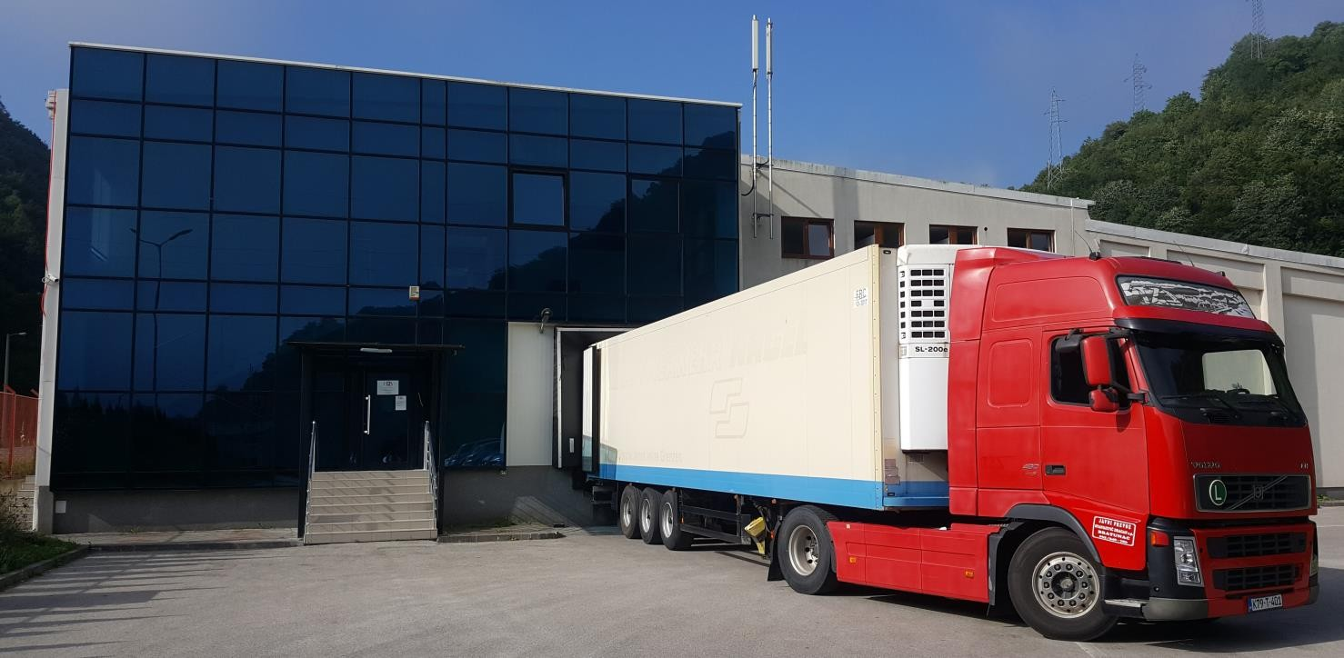
General information
Location: Srebrenica, Republic of Srpska, Bosnia and Hercegovina
Price: 3.000.000 euros

Slide 3
Real estate property of the company
The current land plot under ownership of the company is 8764 m2 of which the office building occupies 3,168 m2 and the rest is land surrounding the factory building. The building itself is formally divided into two parts: facility (ground floor) and administration (first floor). In addition to the office building, there is a separate facility for security guards and a mini power station and waterwell.

Slide 4
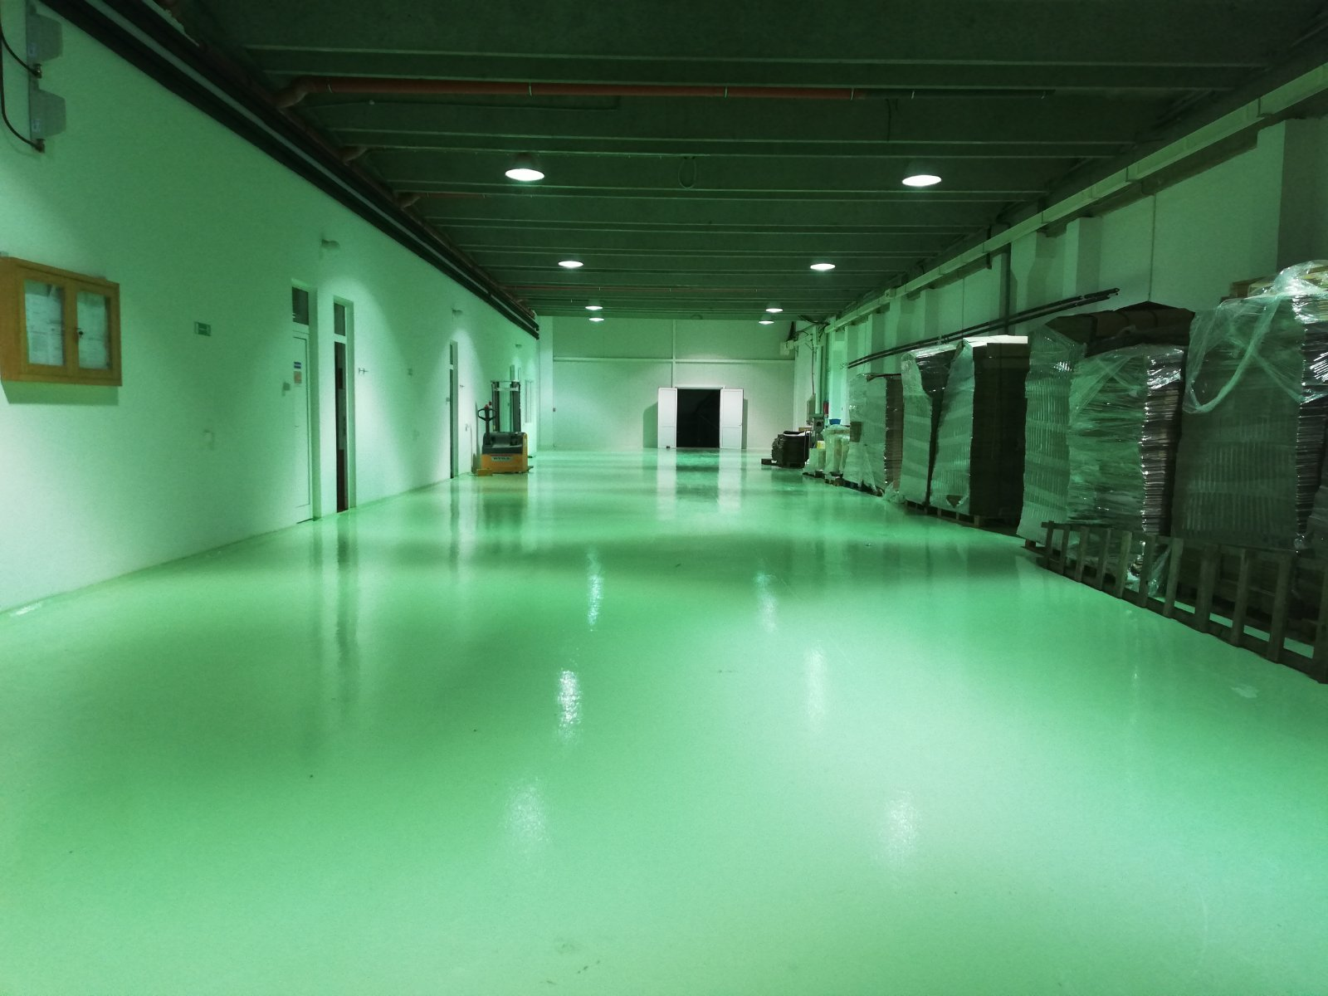
Packaging room
Storage room for packaging material occupies an area of 419.13 m2.
In this room finished fries are packaged as well as cardboard boxes for storage and transport are kept. The average height is 8m.

Slide 5
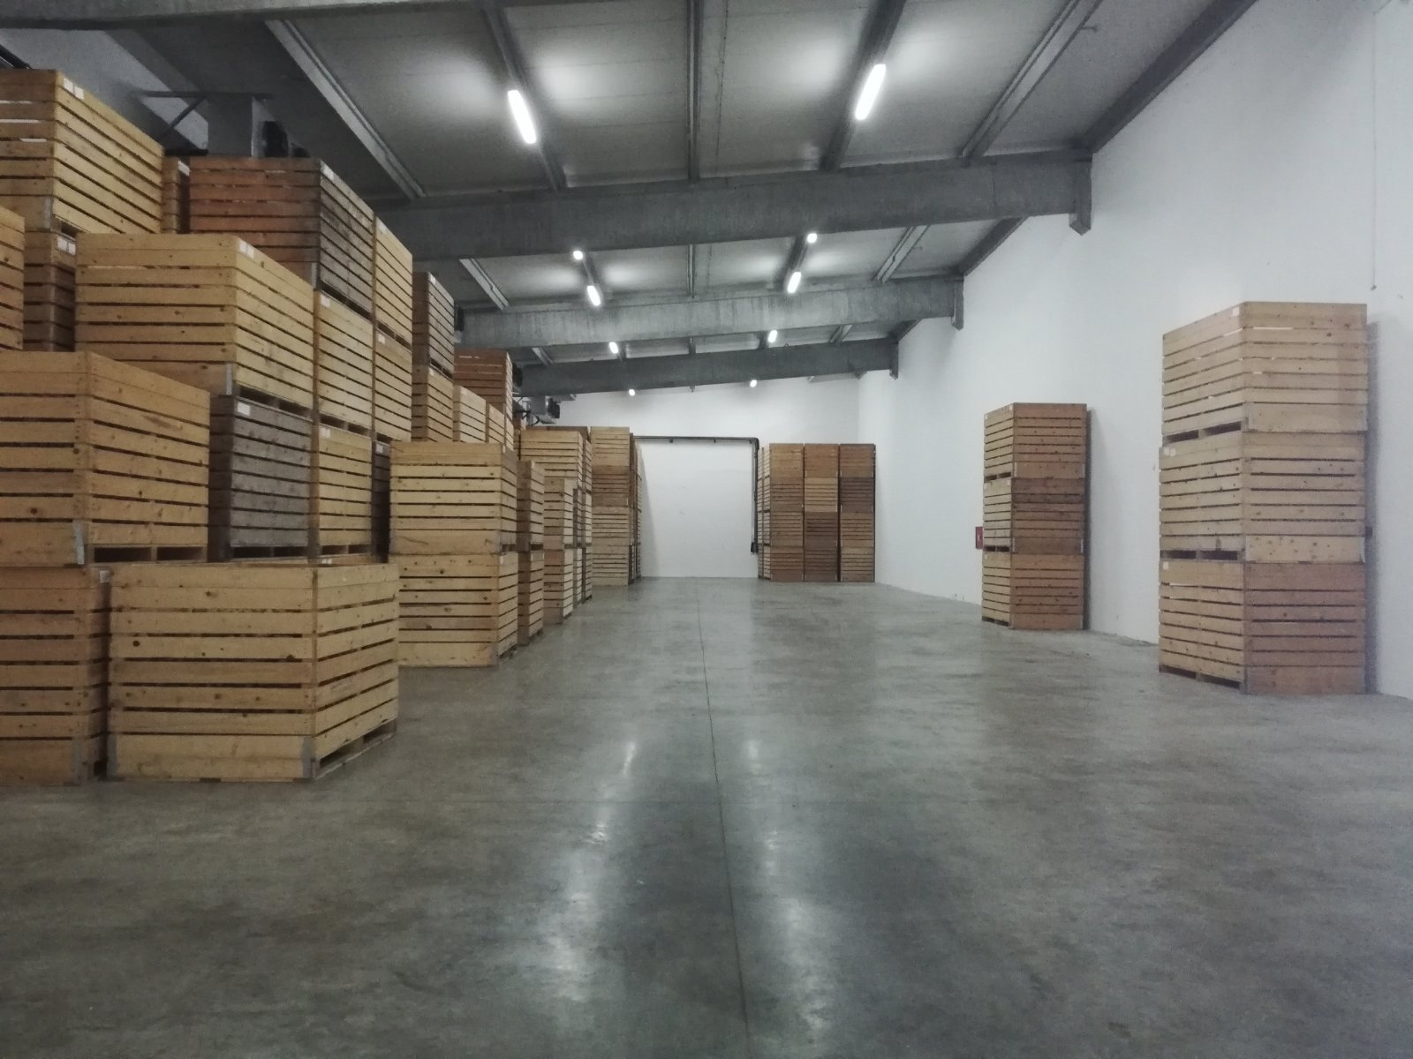
Warehouse 1
Warehouse area is 217,40 m2. It is possible to fit 592 wooden pellets in the warehouse. 1200 kg can be stored on one pellet. It is equipped with valves for regulating the flow of air, as well as apparatus for regulating the temperature.

Slide 6
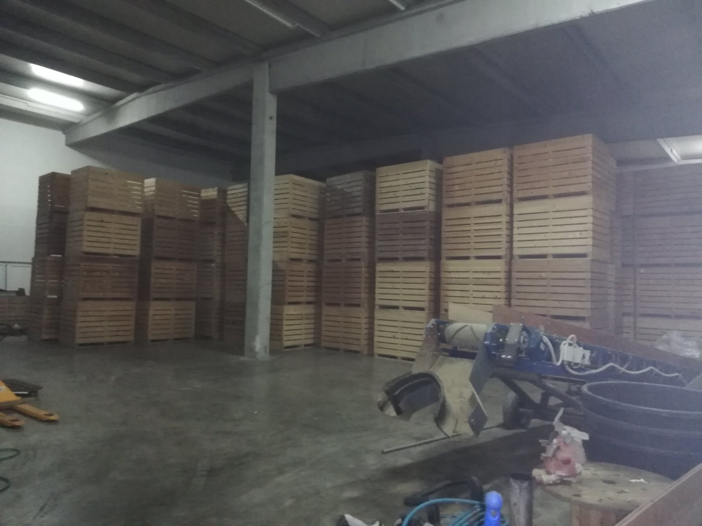
Warehouse 2
This space occupies an area of 783.58 m2, specializing in the storage of raw materials.
It is possible to accommodate 910 wooden boxes, and it is possible to store 1100000kg of raw material
. It is currently used as a storage space for machine parts, considering that the machine is being overhauled, as well as the machines for unloading raw materials (potatoes). The average height is 8m.

Slide 11
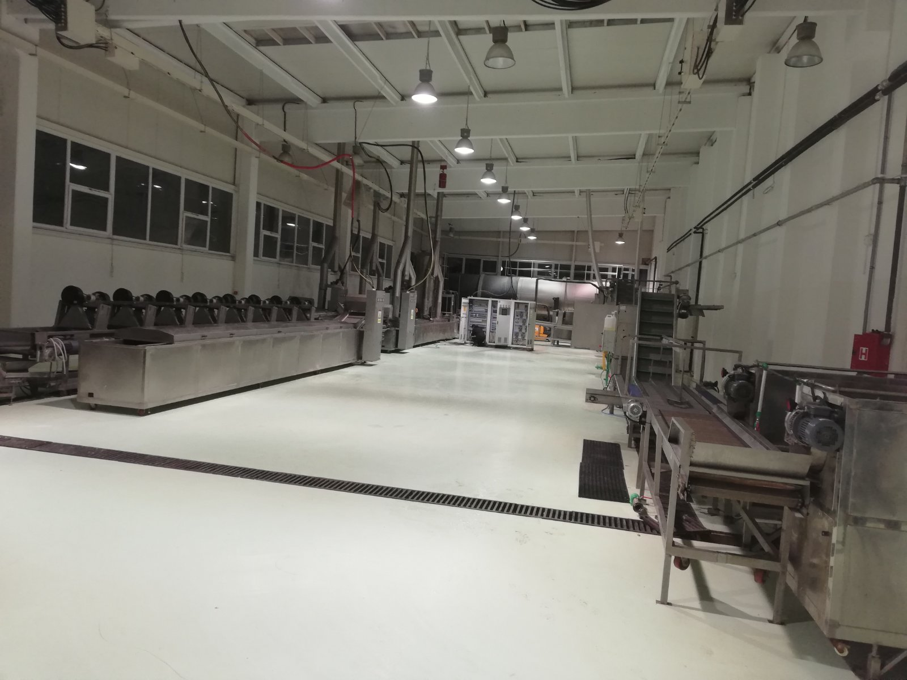
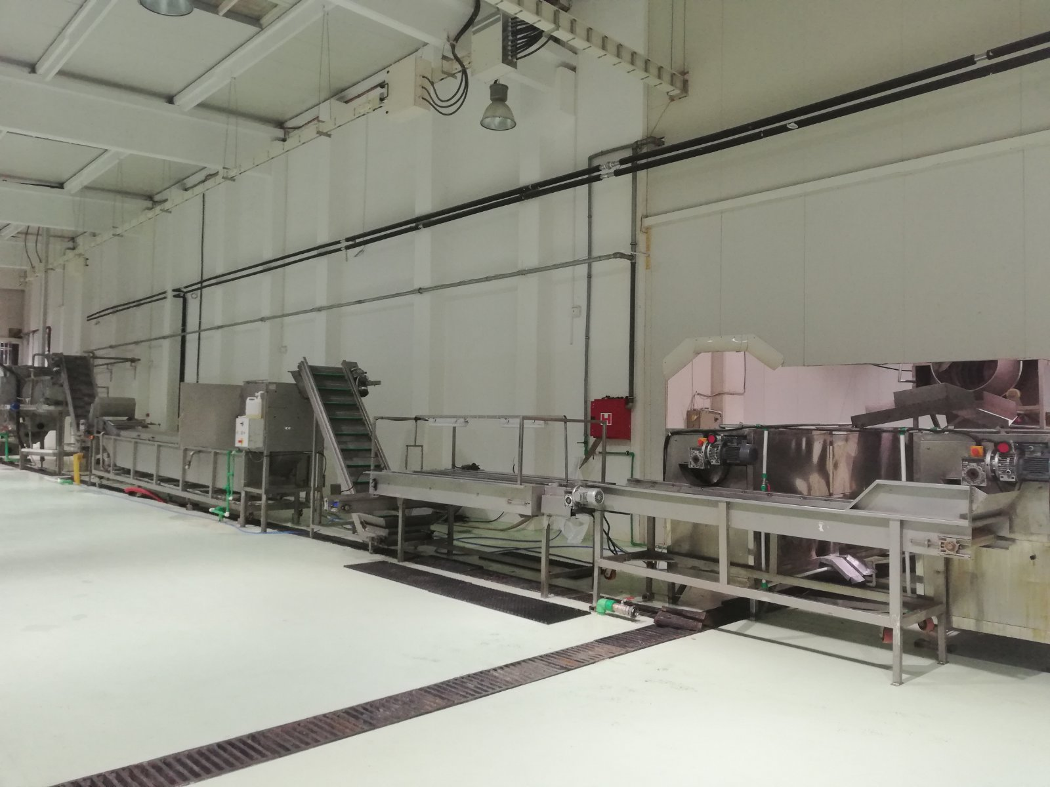
Manufacturing workshop
The production facility is 554,98m2.

Slide 12
Currently there are potato processing machines of which:
Cylinder washer
Location |  | Potato processing line
Manufacturer |  | SHENG KANG, CHINA
Year |  | 2015
Model |  | 2500*1000*1050
Power |  | 2,2kw
Voltage |  | 380V/50h
Capacity | 15m3/h

Slide 14
Inspection belt (2x)
Location |  | Potato processing line
Manufacturer |  | SHENG KANG, CHINA
Year |  | 2015
Model |  | 200*1100*950
Power |  | 0,75kw
Voltage |  | 380V/50h

Slide 16
Sideling transporter (2X)
Location |  | Potato processing line
Manufacturer |  | SHENG KANG, CHINA
Year |  | 2015
Model |  | 3500*880*1390
Power |  | 0,75kw
Voltage |  | 380V/50h

Slide 18
Potato cutter
Location |  | Potato processing line
Manufacturer |  | Sweer
Year
Model
Power |  | 1,5kw
Voltage |  | 380V/50h
Capacity | 1,5t/h

Slide 20
Washer - Plush
Location |  | Potato processing line
Manufacturer |  | SHENG KANG, CHINA
Year |  | 2015
Model |  | 8000*1040*1700
Power |  | 4,4kw
Voltage |  | 380V/50h
Capacity | 3000l

Slide 22
Calibrator
Location | Potato processing line
Manufacturer | Serbia
Year | 2017
Model
Power | 0,75kw
Voltage | 380V/50h

Slide 24
Blancher (2x)
Location |  | Potato processing line
Manufacturer |  | Israel
Year
Model
Power |  | 2,2kw
Voltage |  | 380V/50h
Capacity | 2000l
Working temperature 80C.

Slide 26
Transport belt with warm air
Location |  | Potato processing line
Manufacturer |  | SHENG KANG, CHINA
Year |  | 2015
Model |  | 6000*990*1700
Power |  | 26,2kw
Voltage |  | 380V/50h

Slide 28
Vibrating transporter (2X)

Slide 29
The fryer
Location |  | Potato processing line
Manufacturer |  | SHENG KANG, CHINA
Year |  | 2015
Model |  | 1200*1250*2400
Power |  | 368,8kw
Voltage |  | 4000V /50Hz
Capacity | 2100 l
Working temperature 140-180C.

Slide 32
Sideling collection transporter
Location |  | Potato processing line
Manufacturer |  | SHENG KANG, CHINA
Year |  | 2015
Model |  | 2000*1100*1000
Power |  | 0,55kw
Voltage |  | 380V/50h

Slide 34
Cold air transport belt
Location |  | Potato processing line
Manufacturer |  | SHENG KANG, CHINA
Year |  | 2015
Model
Power |  | 14,2kw
Voltage |  | 380V/50h

Slide 36
Sideling transporter with vibration
Location |  | Potato processing line
Manufacturer |  | SHENG KANG, CHINA
Year |  | 2015
Model |  | 3500*880*1390
Power |  | 0,75V
Voltage |  | 380V/50h

Slide 38
Shock tunnel
Location |  | Potato processing line
Manufacturer |  | SHENG KANG, CHINA
Year |  | 2015
Model |  | 16240*3600*3800
Power |  | 103kw
Voltage |  | 380w/50h
Capacity | 2t/h
Working temperature is -36C.

Slide 40
These machines are part of the line for processing potato and for the production of French fries. They are currently in working order. In addition to these machines, there are the following machines in use, which are used for processing broccoli and cauliflower:
Blancher (electrical) - Working temperature 80C.
Location |  | Potato processing line
Manufacturer |  | SHENG KANG, CHINA
Year |  | 2015
Model |  | 10000*1230*1750
Power |  | 182,2kw
Voltage |  | 380w/50h
Capacity | 2T/H
Volume | 4000l

Slide 42
The fryer
Location |  | Potato processing line
Manufacturer |  | SHENG KANG, KINA
Year |  | 2015
Model |  | 1200*1250*2400
Power |  | 368,8kw
Voltage |  | 4000V /50Hz
Volume

Slide 44
Mixer for adding Natrium Pyrophosphat

Slide 45
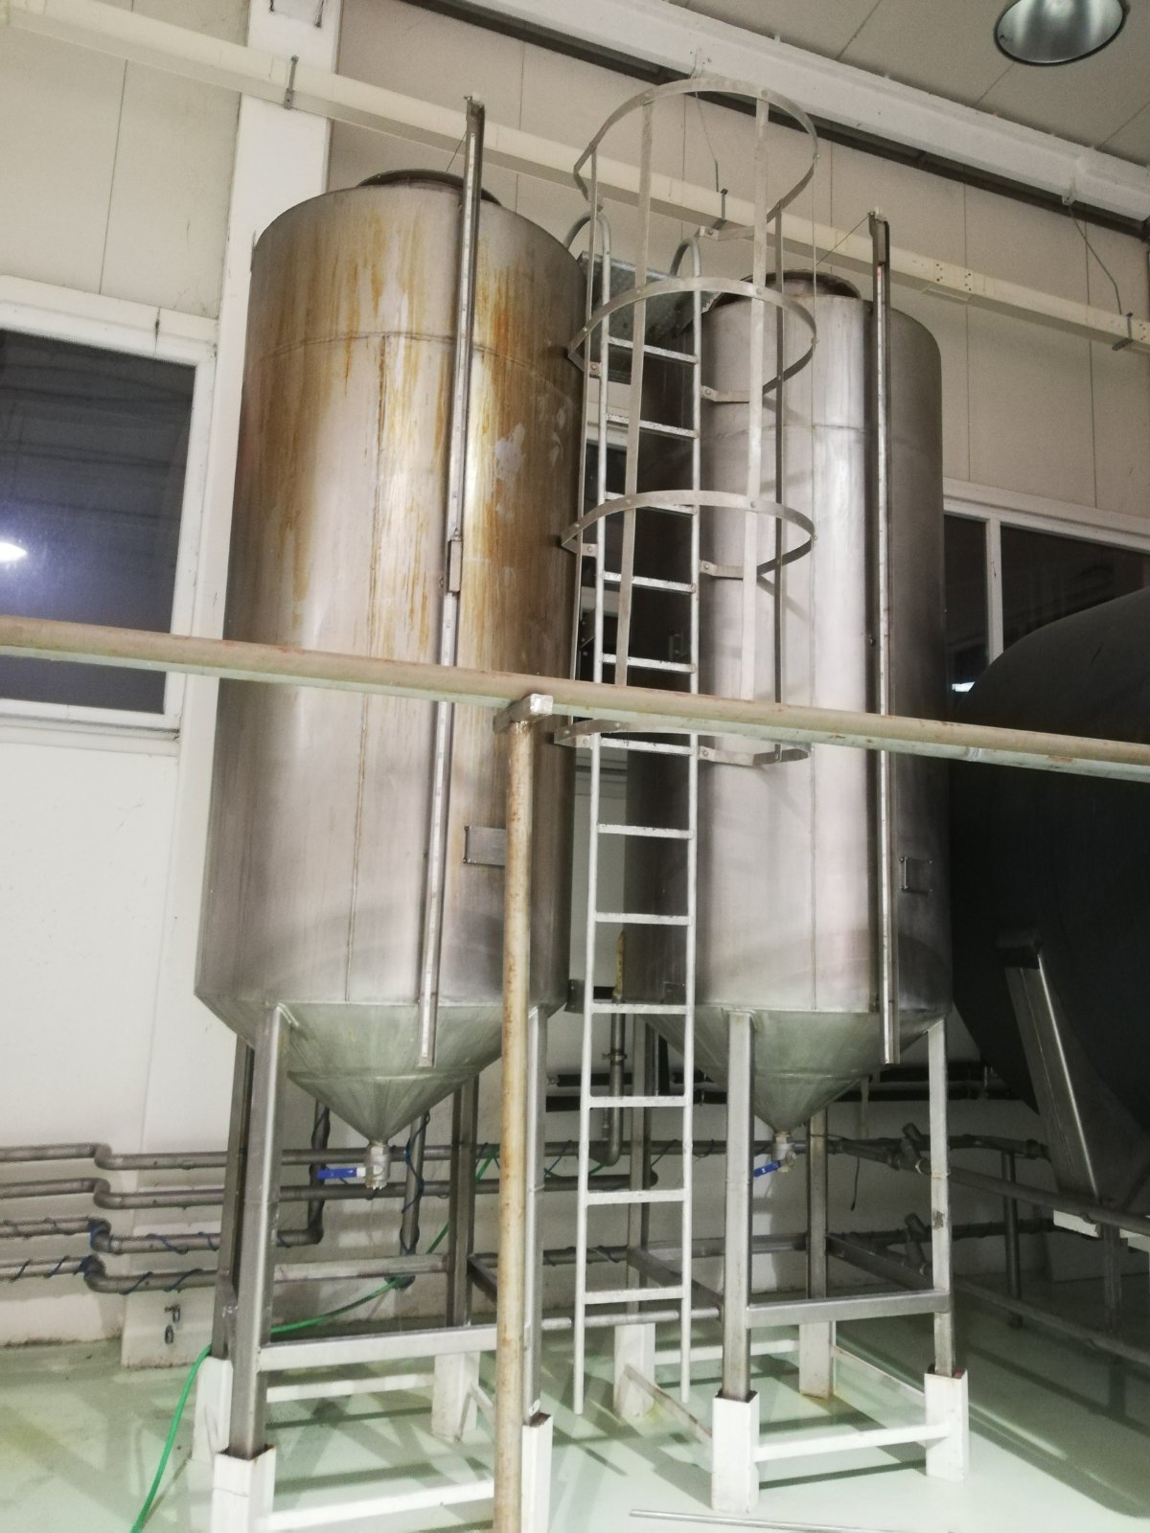
Palm oil process tank (Palmolein)
Volume 3000l . 2x

Slide 46
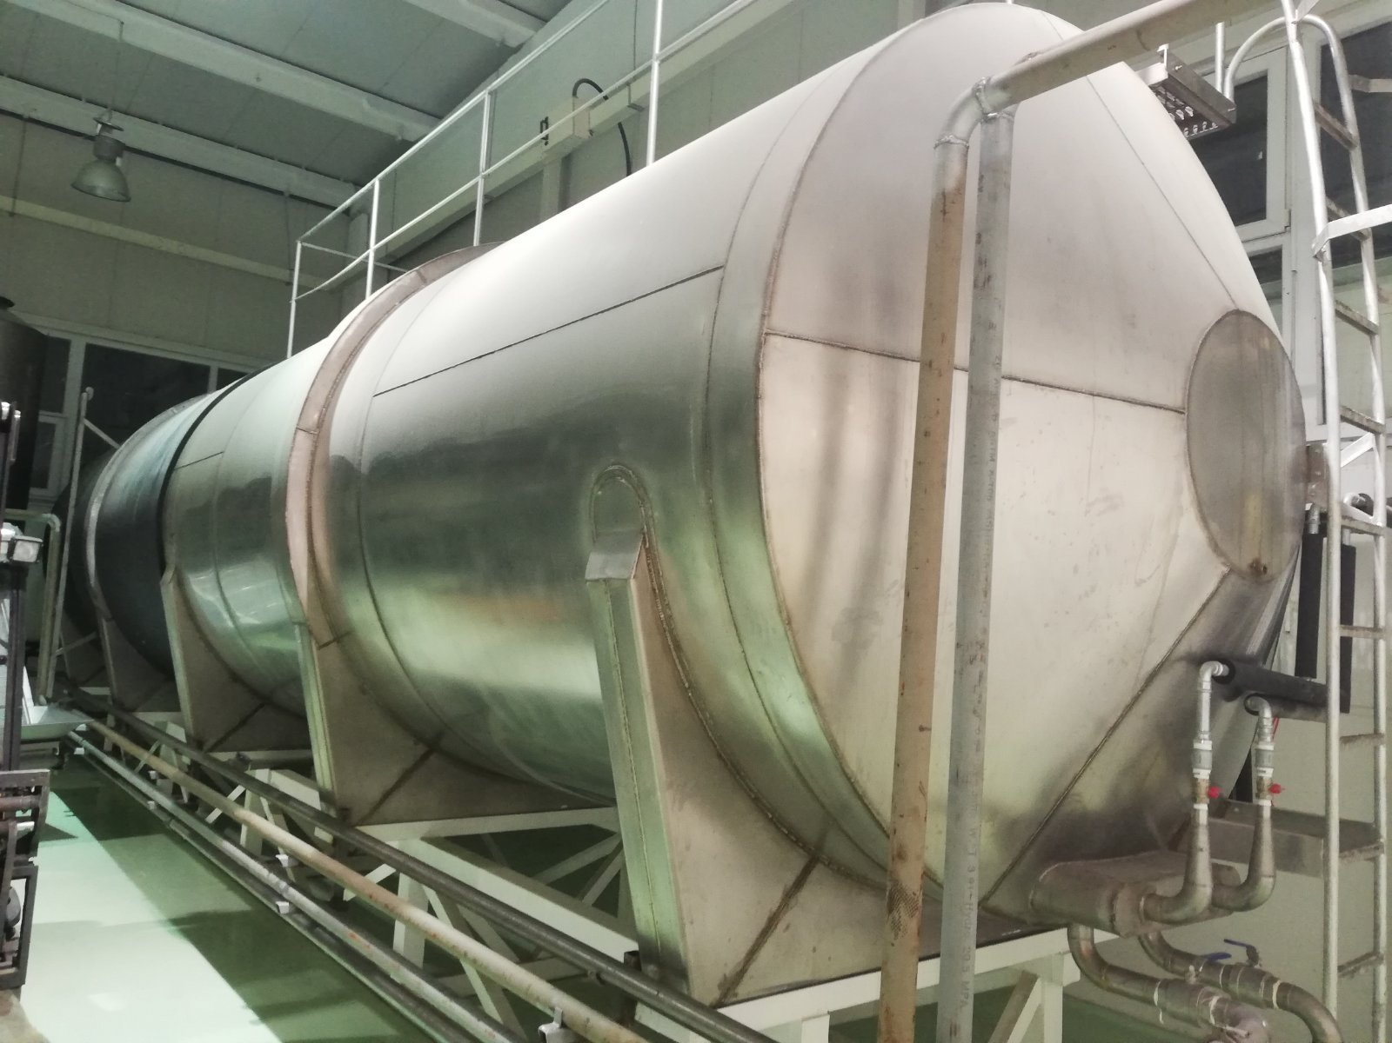
Palm oil tank (Palmolein)
Volume 60T

Slide 47
Packaging room
The total area is 163.60m2.
Currently, there are two packaging machines for packaging the finished product.
Packers are adjustable and can pack sacks of
-0.75kg 1
-1kg
-2.5kg

Slide 48
The packaging room contains:
Finished product transporter
Location |  | Packaging room
Manufacturer |  | SHENG KANG, CHINA
Year |  | 2015
Model |  | 8500*720*1200
Power |  | 1,1kw
Voltage |  | 230V

Slide 49
Packaging machine (2x)
Location |  | Potato processing line
Manufacturer |  | SHENG KANG, CHINA
Year |  | 2015
Model |  | GQ-720
Power |  | 4KW
Voltage |  | 230V
Capacity | 800kg/h

Slide 51
Cold storage
Area of cold storage room is 186,34m2.
Capacity is 150000kg.
Currently there is amount of:
-French fries - 16089kg
-Broccoli - 5321kg
-Cauliflower - 1842kg
Temperature is -18C.

Slide 55
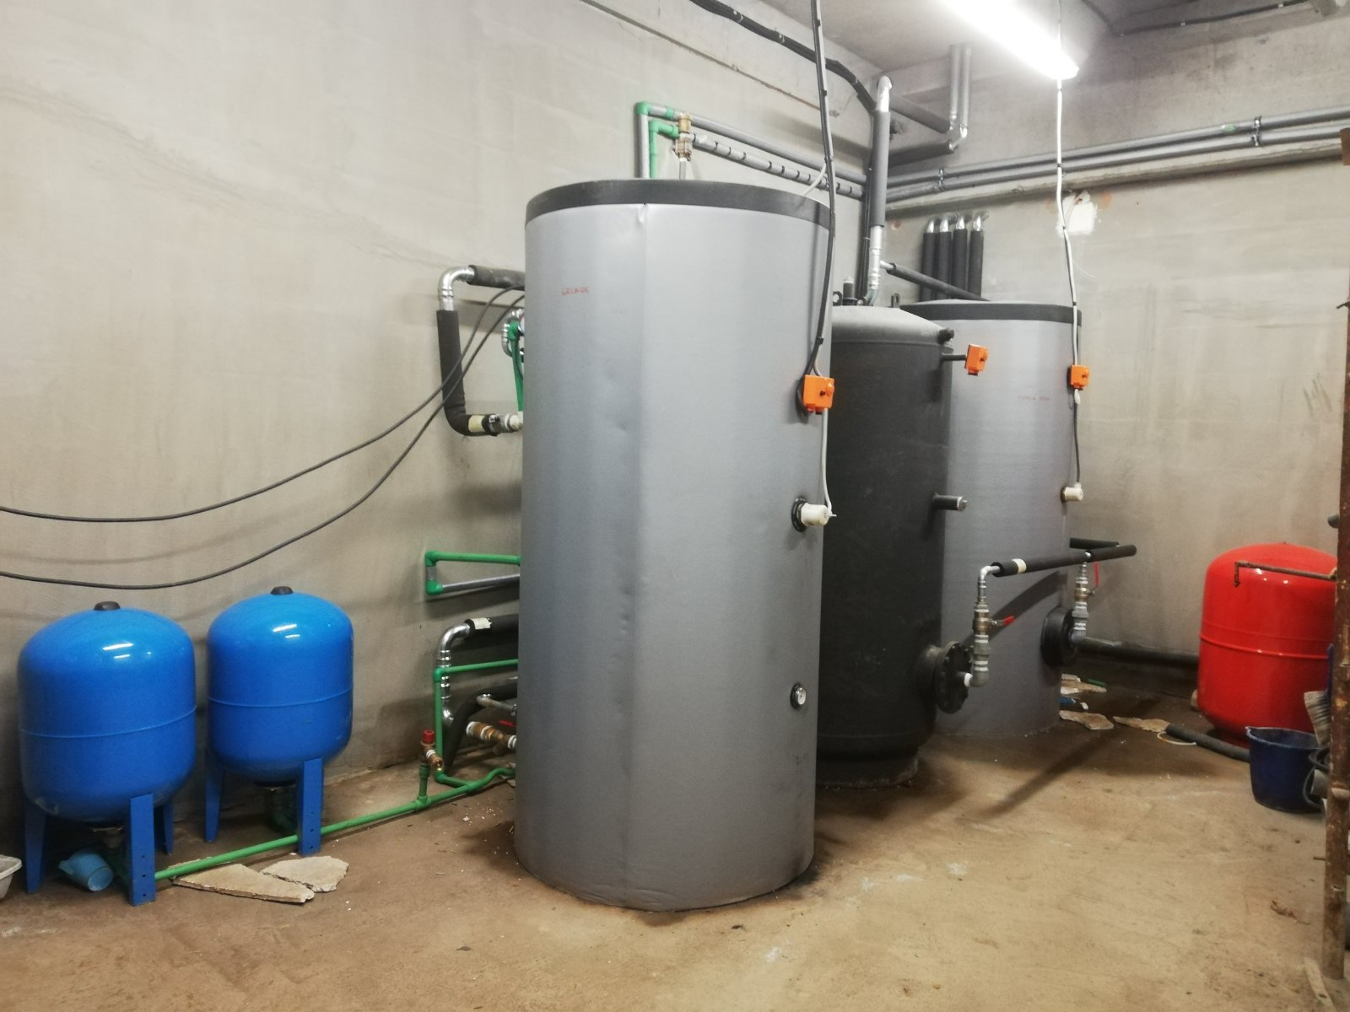
Boiler room
The area is 31,07m2.
The room currently houses under-floor heating equipment.

Slide 56
Storage room
The area of the room is 7.35m2.
Currently is used for the storage of chemicals, that are used for the hygiene, cleaning and washing of propulsion machines.

Slide 58
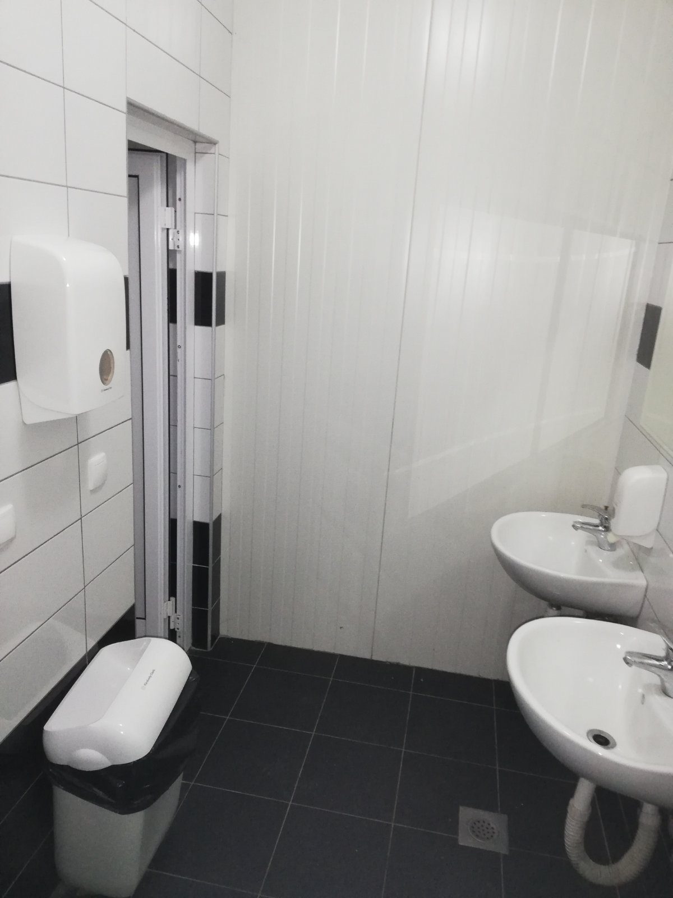
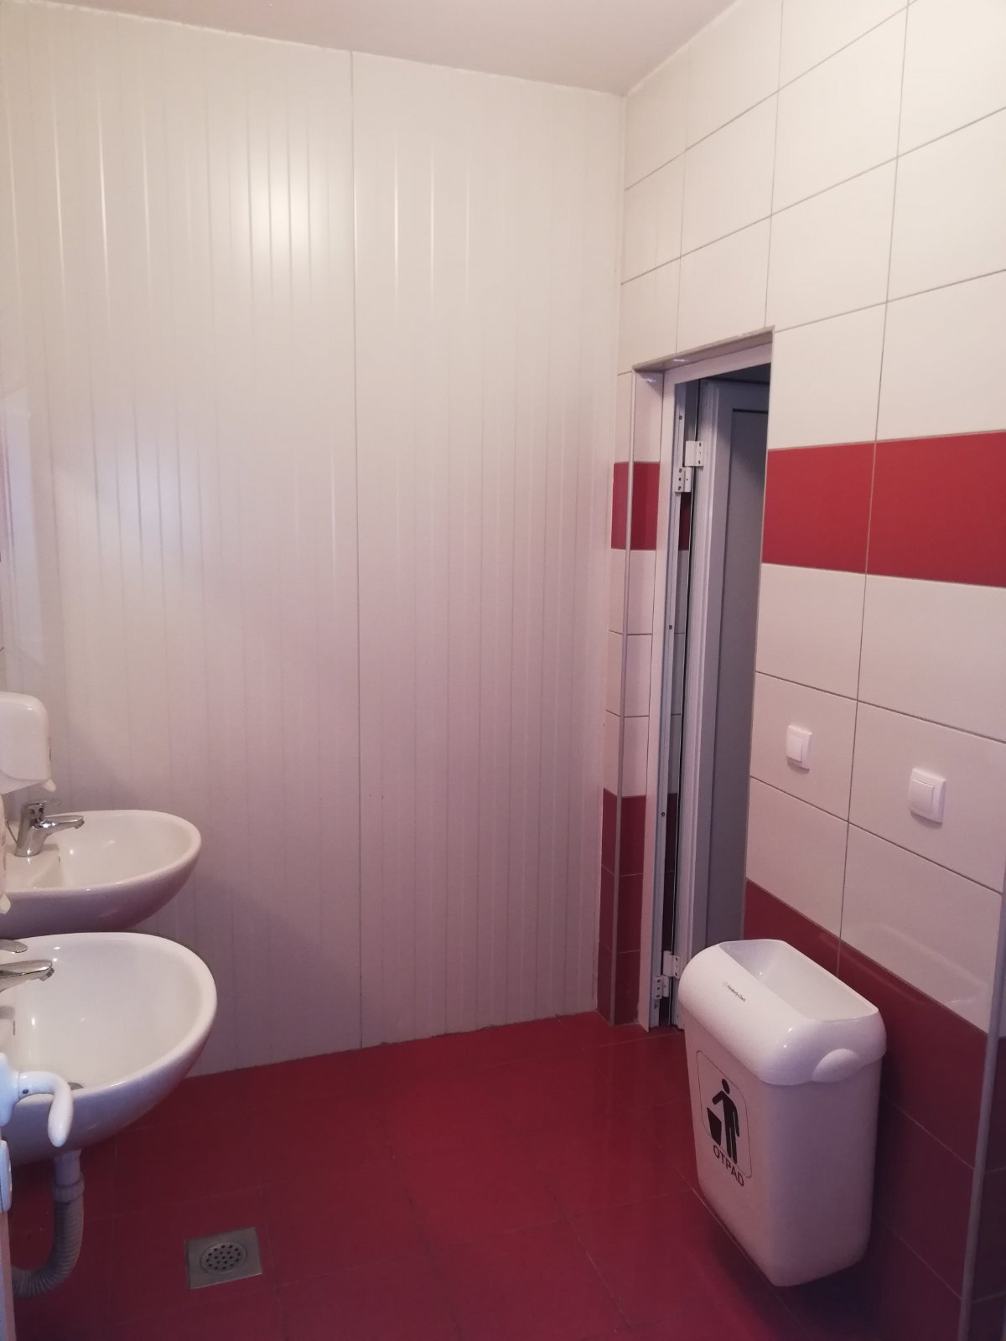
Toilets
Two toilet rooms (man and woman)
Total area 16,12m2.
Fully equiped with furniture.

Slide 59
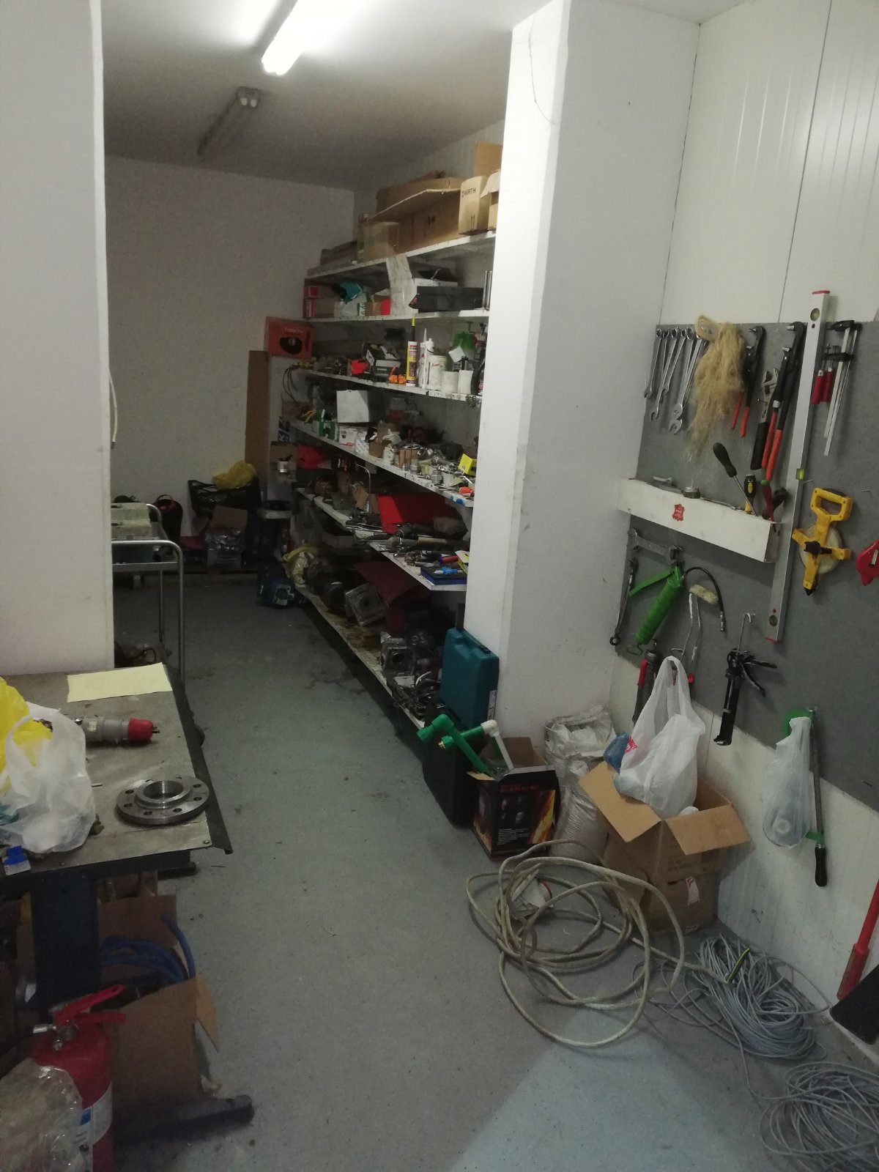
Workshop
The room covers an area of 18.05m2
In use for tool storage

Slide 60
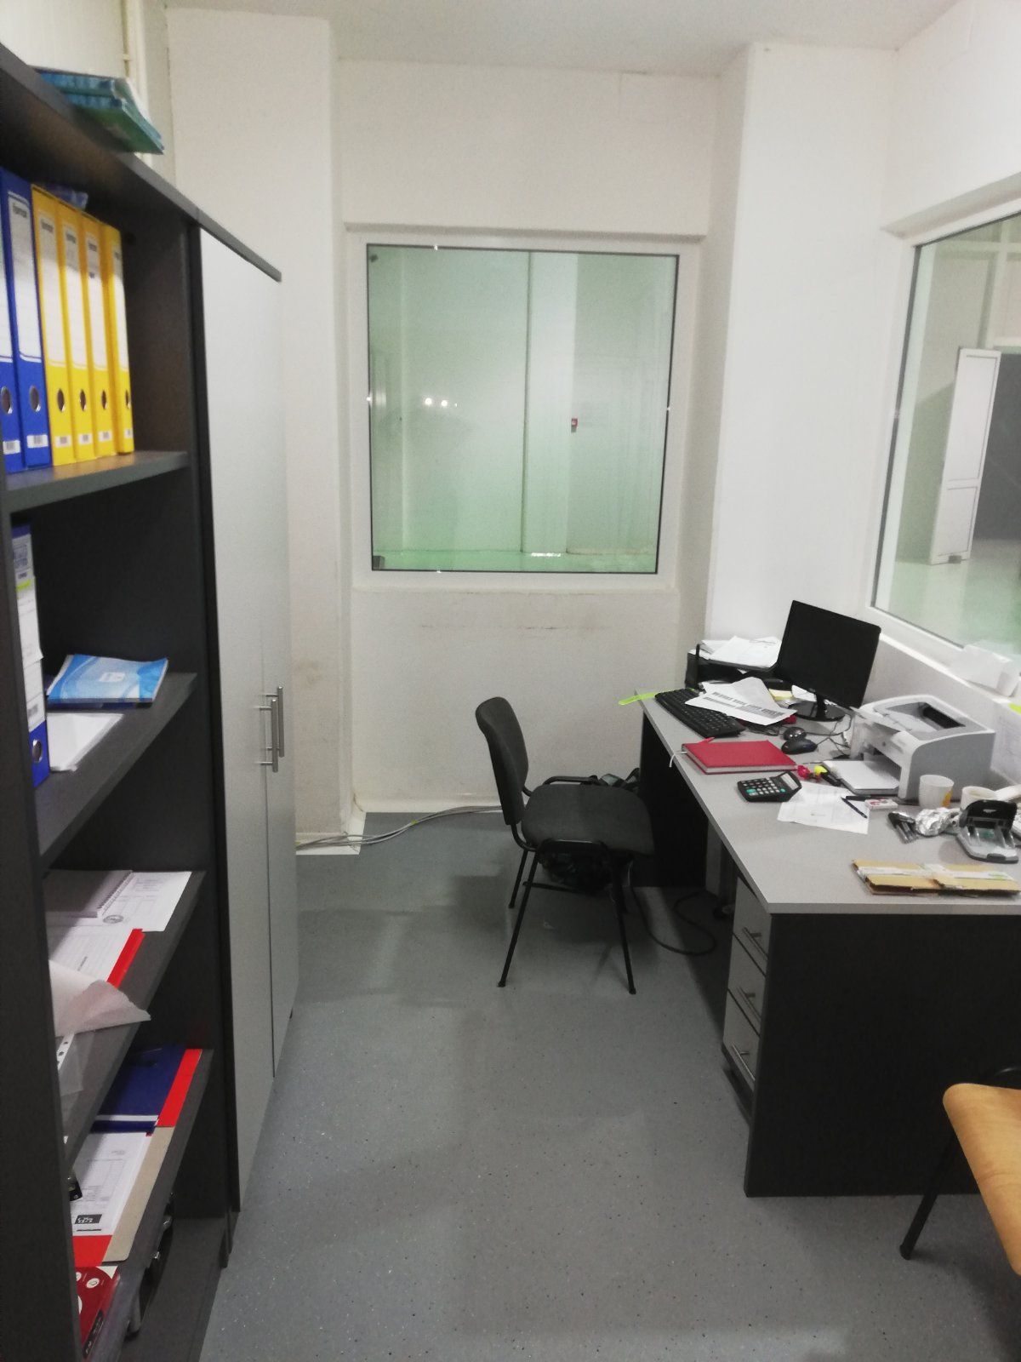
Office
The area is 9,70m2
room is intended as a warehouse office

Slide 61
Hall
The total area of the hall is 69.06m2.
Part of the plant where raw materials are received.
There is a potato receiving machine that sends the potatoes into operation.

Slide 63
Potato receiving machine
Location | Hall
Manufacturer | VIBRATECH
Year | 2015
Model | Pdk2*2,8
Power | 2,2kw
Voltage | 380w/50h

Slide 65
Potato Crokettes machine
Location | Hall
Manufacturer | GASER
Year | 2021
Model | Gaser S-1500-PC
Power | 1,65kw
Voltage | 380w/50h

Slide 66
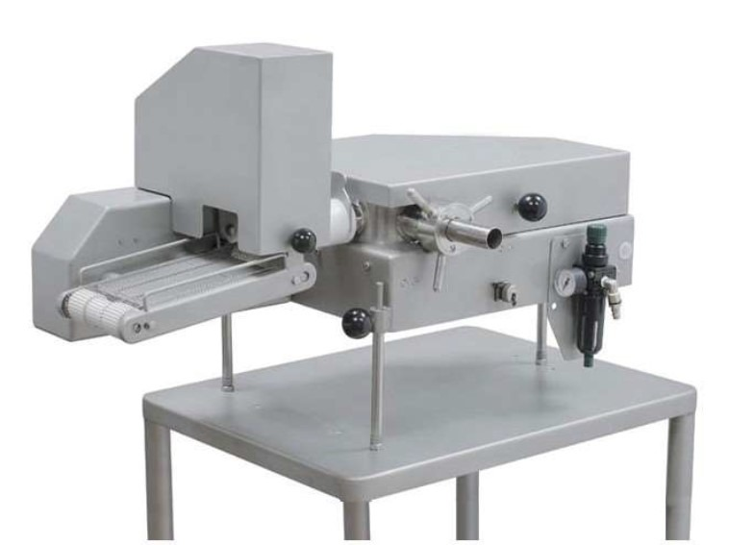
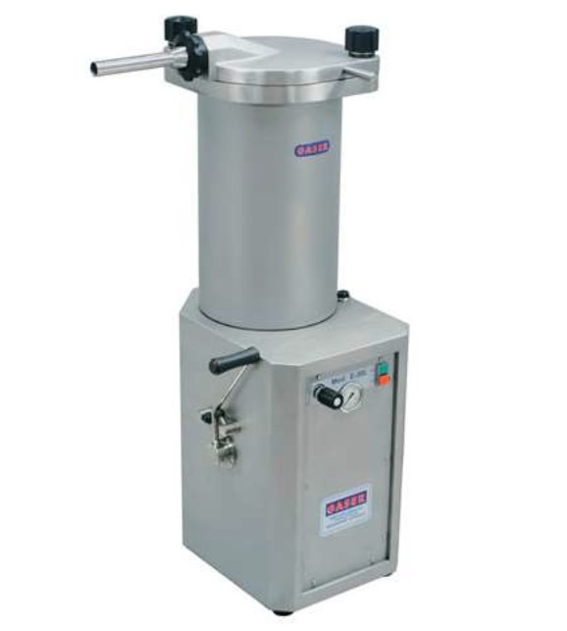
Potato Crokettes machine

Slide 67
Other assets belonging to the company
Garage of 250m2
-The boiler room of 250m2, where is currently located boiler with power of 2.2GW.
- Equipment for receiving raw material (basket, transporting belt, Sideline transporter belt, calibrator, hidrauic sideline transporting belt, mobile transporting belt 2x)
-Compressor for the packer, volume 270 l, pressure 11bar.
- Boiler compressor
-Compressor
Equpment for cleaning the production line after its use
-Forklift (electric pallet truck - Still, JUNGHEINRICH forklift, TOYOTA forklift)
- Three hand pallet lifters

Slide 79
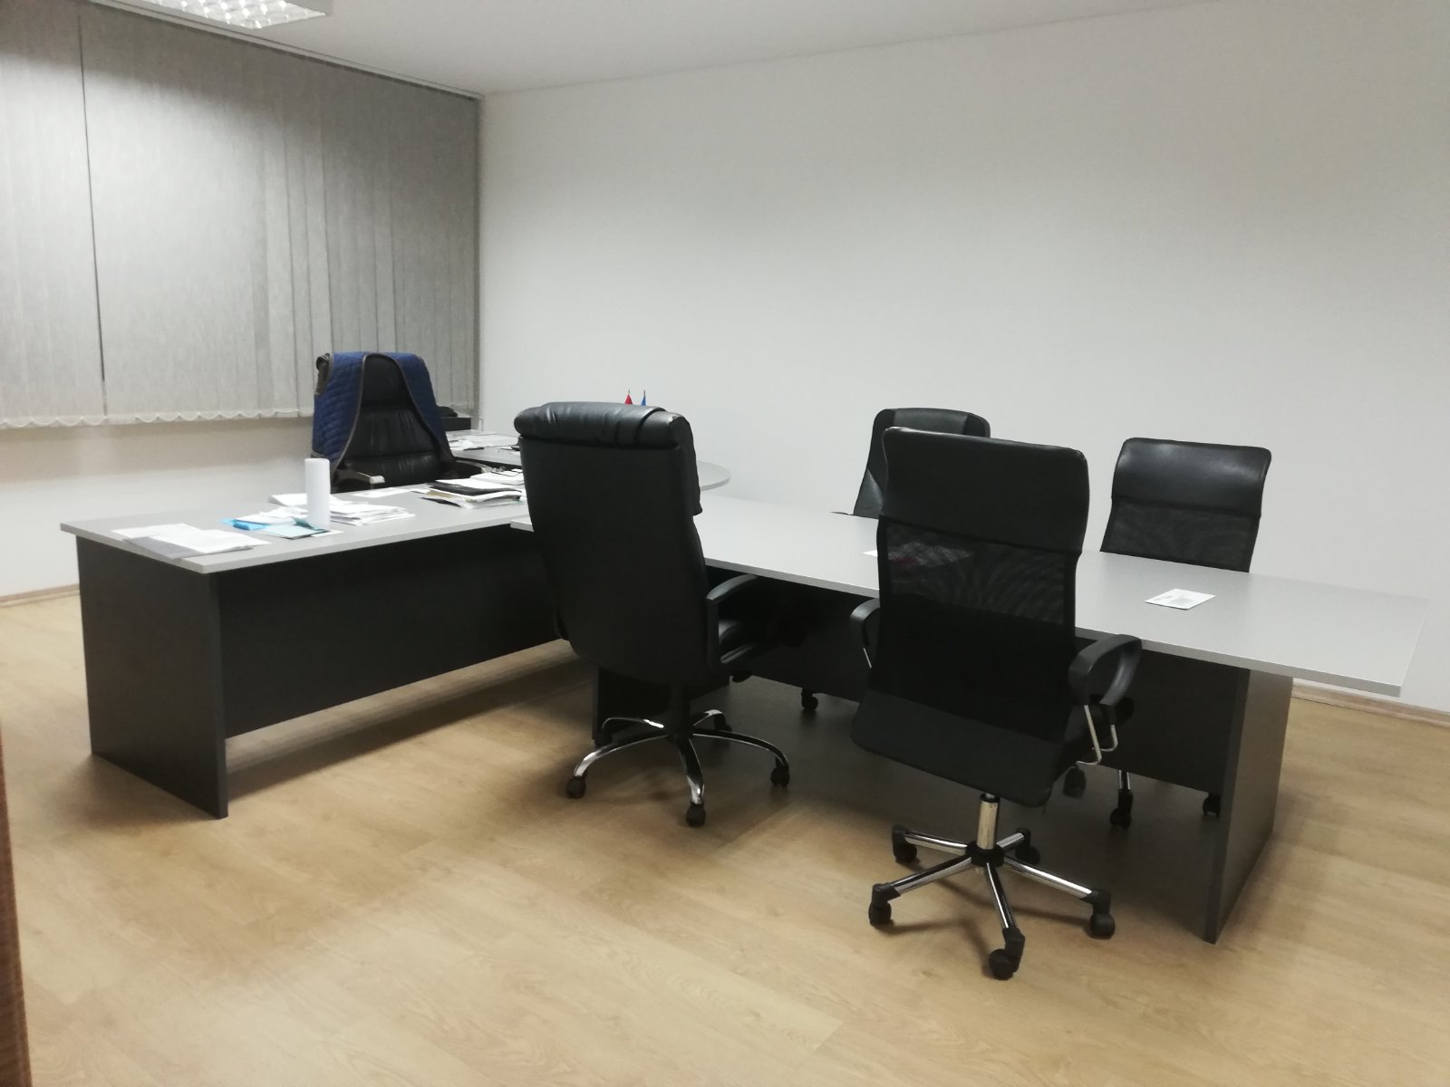
Office of CEO & Conference room
On the first floor of the office building are the following premises:
1. CEO's offices - 31,97m2
Room is currently in use by CEO and it is fully equipped with office furniture.

Slide 80
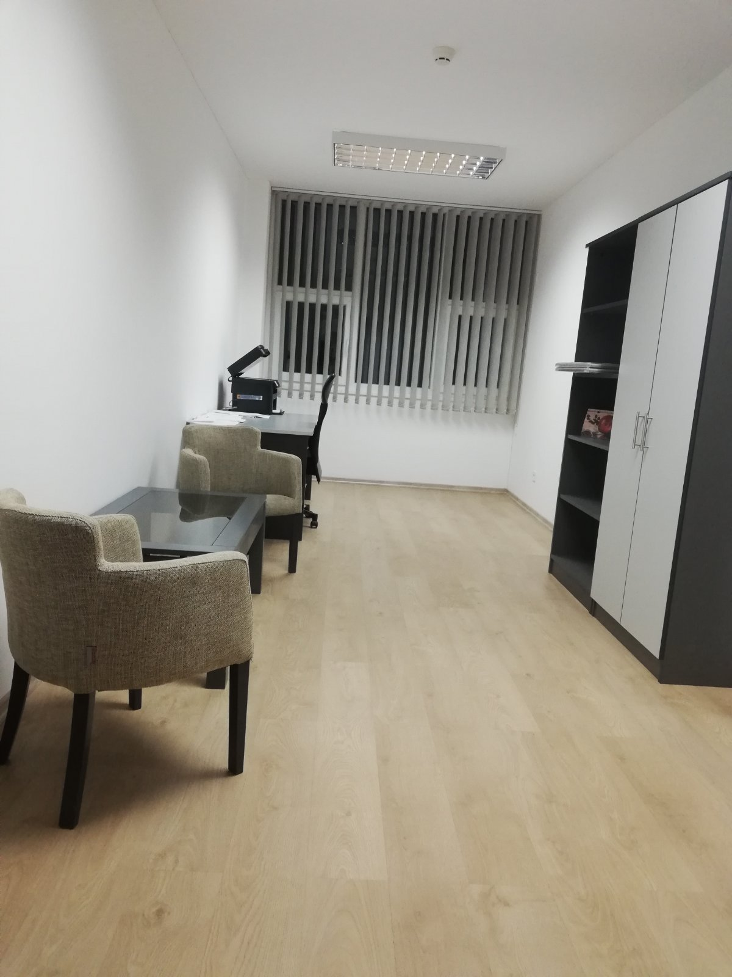
2. Office for Assistant Director -
Currently is used as copy room and it is equipped
20,71m2

Slide 81
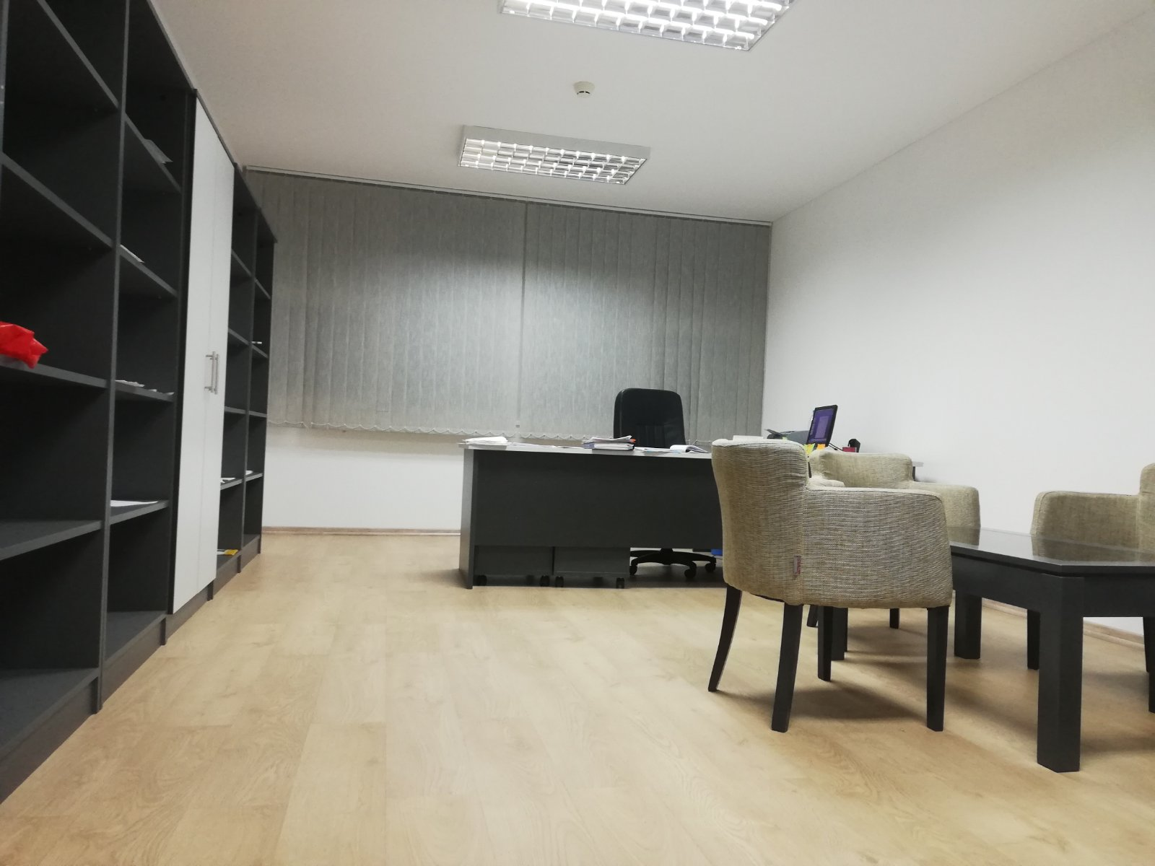
3. Office for the Deputy Director
Fully-equipped with office furniture
29,89m2

Slide 82
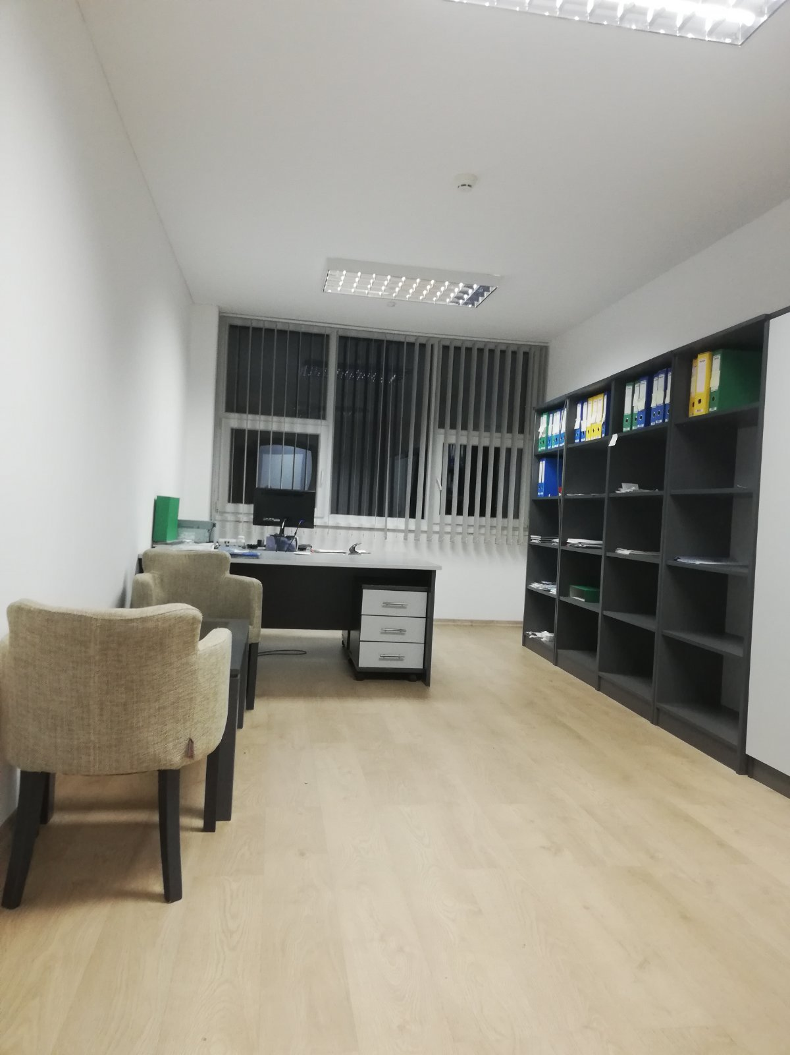
4. Accountant's office
Fully equipped with office furniture.
22,80m2

Slide 83
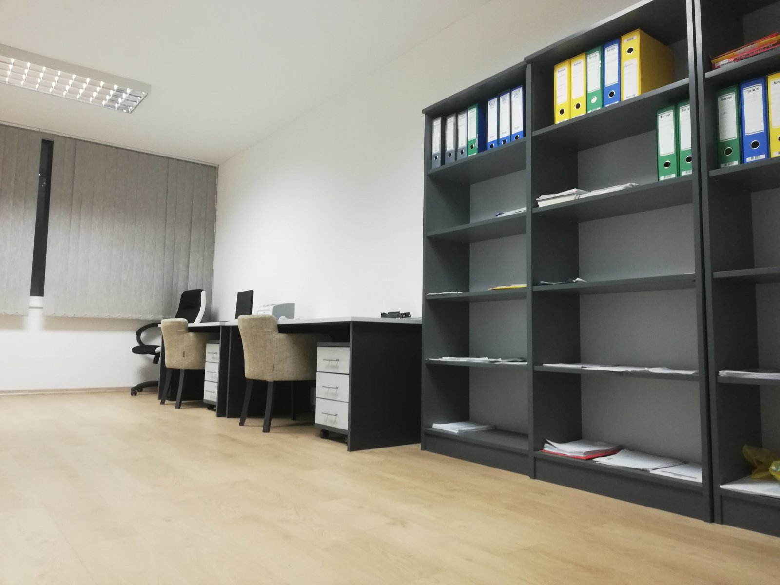
5. Technologist's office 26,60m2
Fully equipped with office furniture.
26,60m2

Slide 84
6. Office of the Production Director -
Room is not in use
Fully equipped with office furniture.
26,62m2

Slide 85
7. Technical room - 14,42m2
Room is in used
Fully equipped with computers for video surveillance
14,42m2

Slide 87
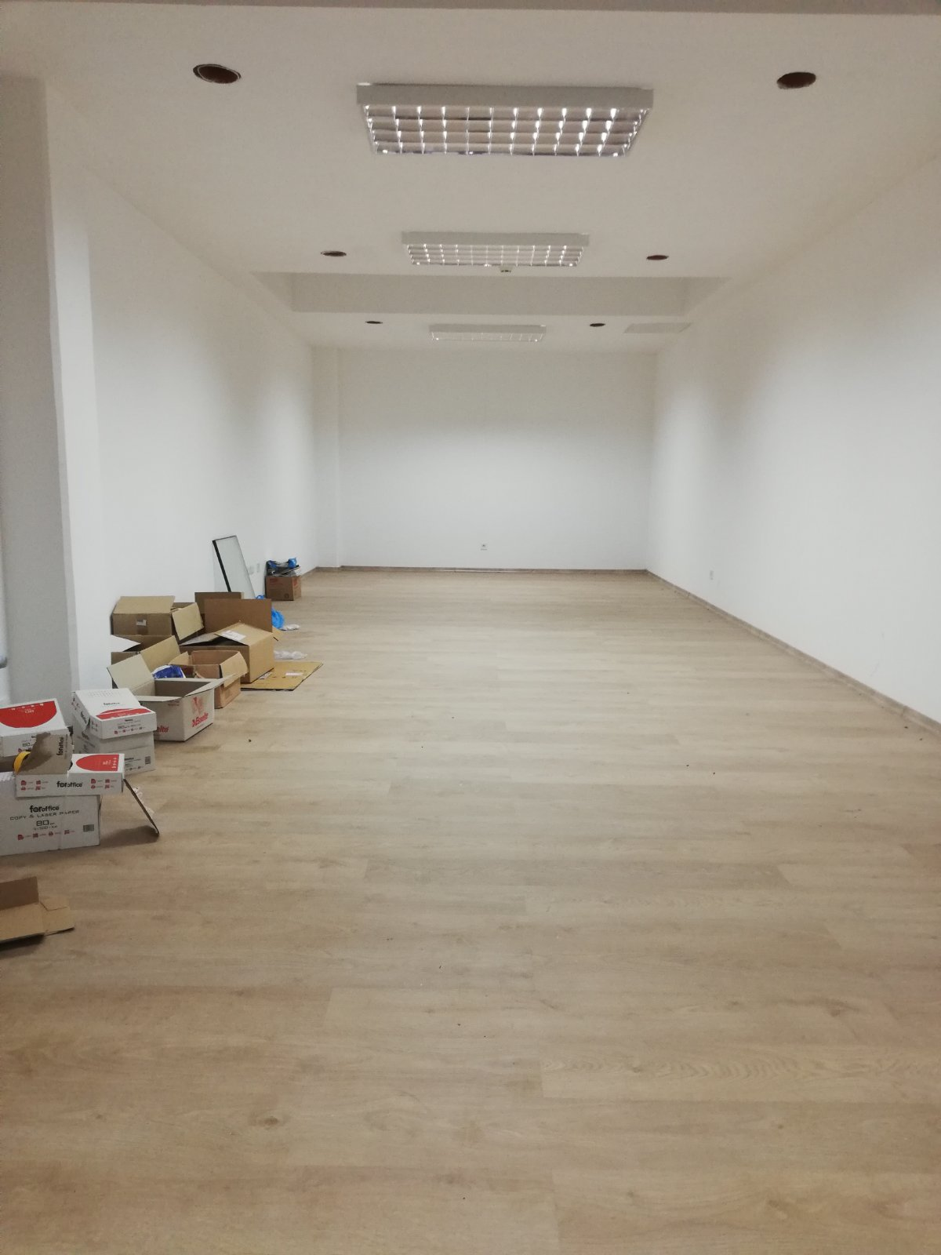
8. Meeting room -
Room is fully equipped with office furniture.
56,96m2

Slide 88
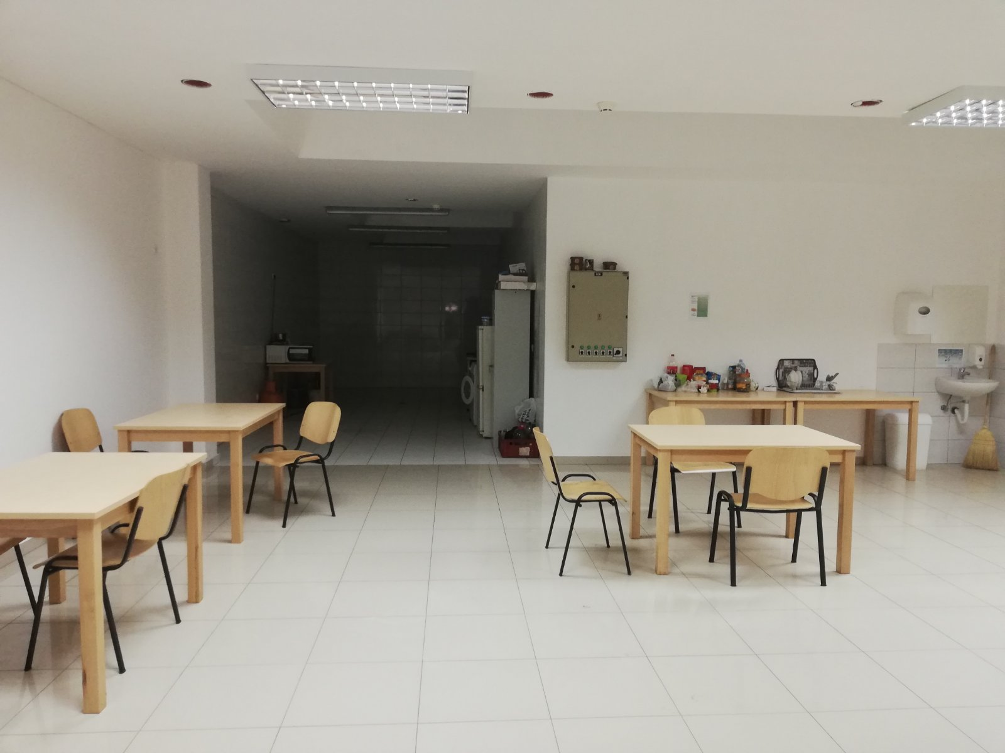
9. Kitchen & Canteen
Kitchen currently in not use
Fully equipped with kitchen furniture.
84,48m2

Slide 89
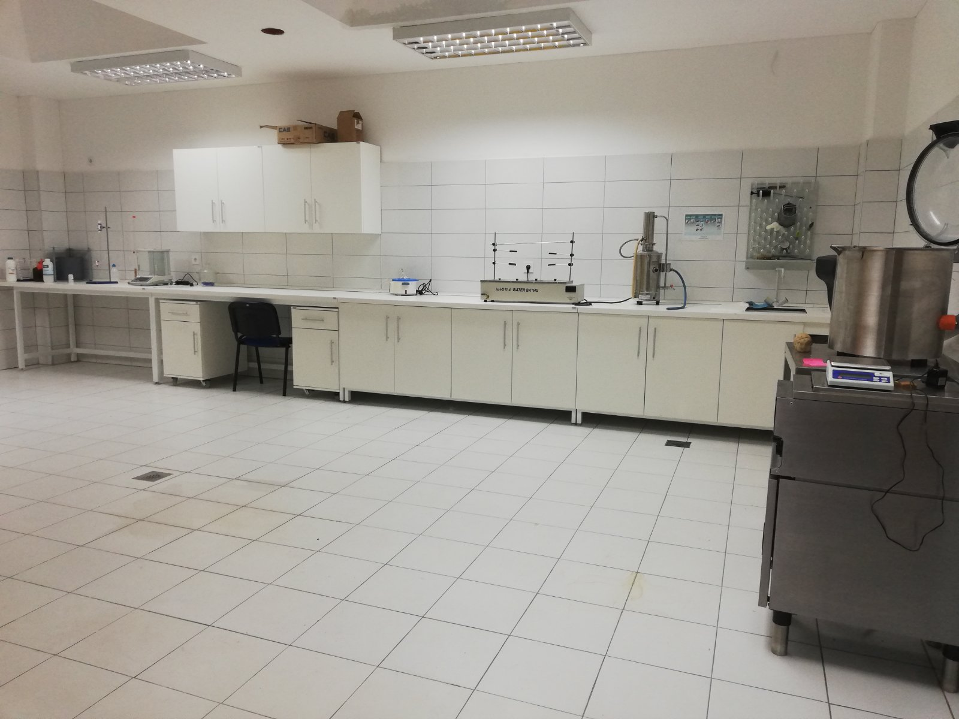
10. Laboratory
Room in equipped with laboratory furniture
43.88 m2

Slide 90
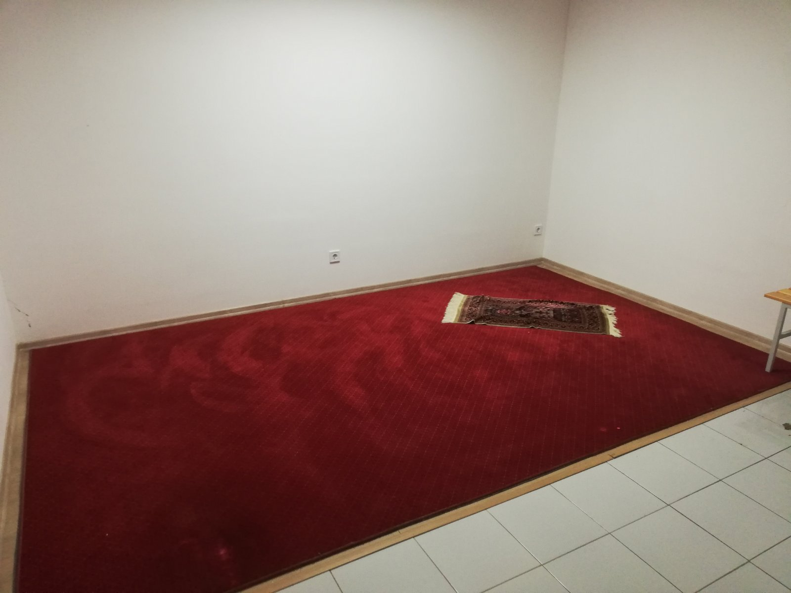
11. Prayer room -
Room is intented for prayers
16,38m2

Slide 91
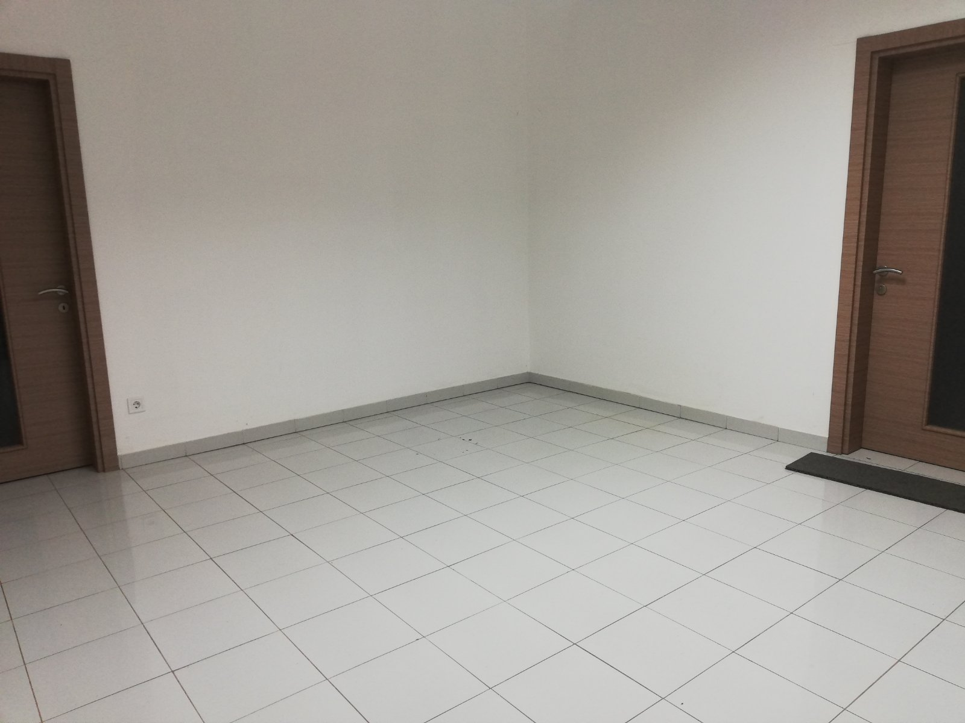
12. Office
Fully equipped with office furniture
16,38m2

Slide 92
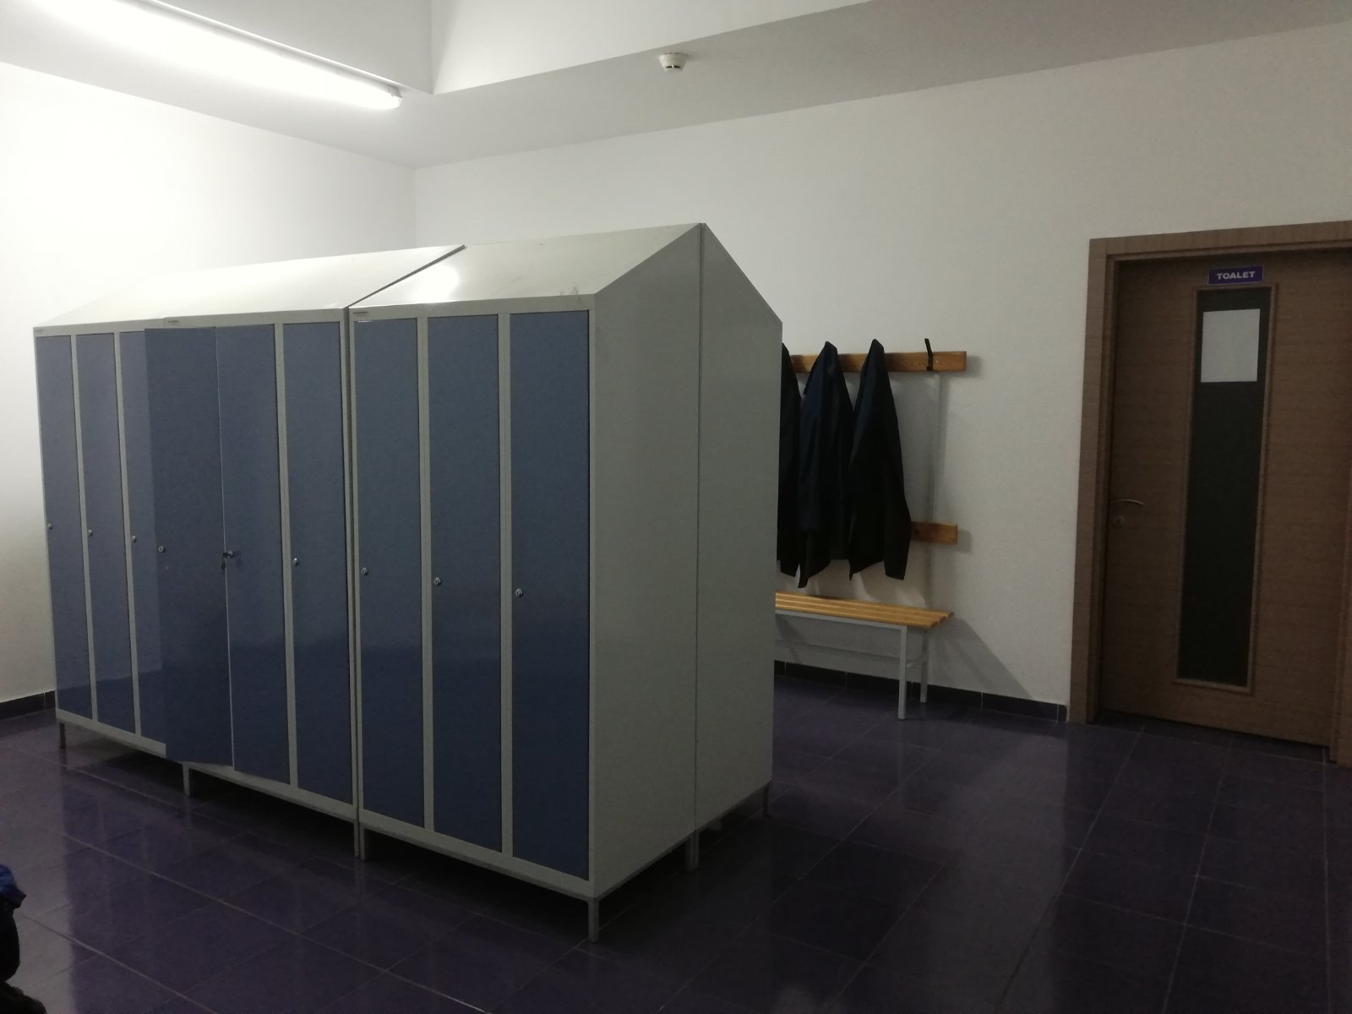
13. Women's wardrobe
Contains 15 lockres, showers and two toilet.
22,79m2

Slide 94
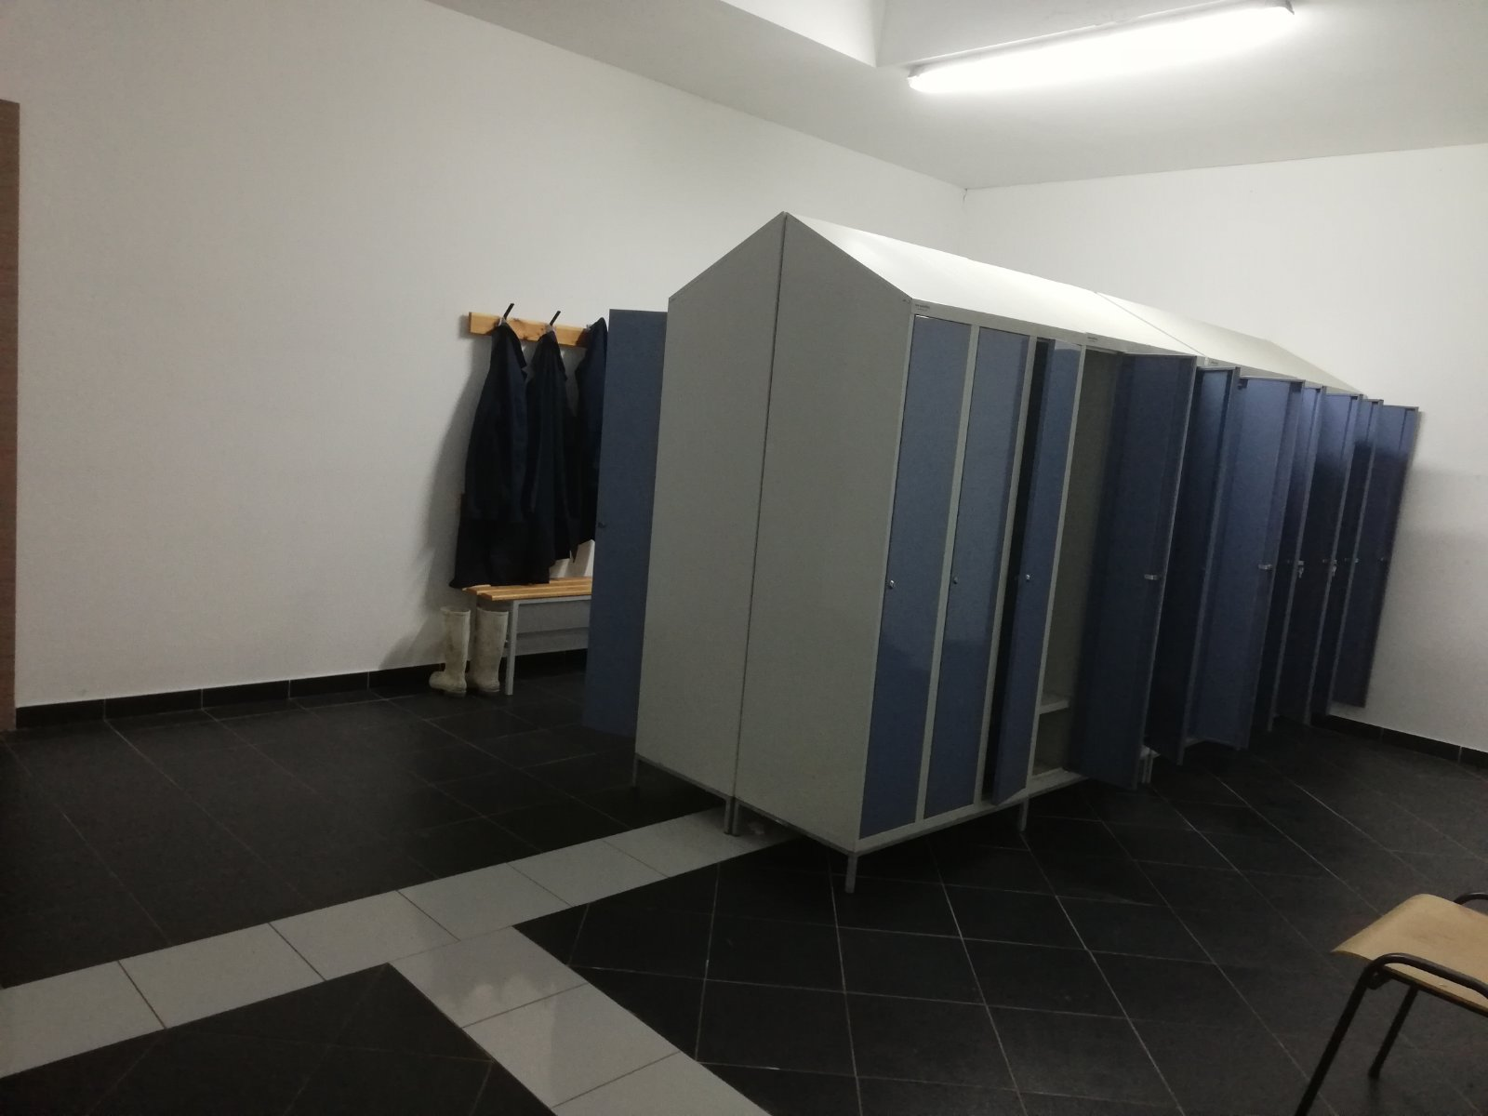
14. Men's wardrobe
Contains 15 lockres, showers and two toilet.
22,85m2

Slide 96
15. Male toilet
3 toilets + shower
Room in equipped with sanitary furniture.
38,86m2

Slide 98
16. Female toilet
3 toilets + shower
Room in equipped with sanitary furniture.
34,53m2

Slide 100
17. Apartments
Four apartments: 2 * 19,66m2 / 2 * 22,77m2
Rooms are fully equipped with furniture – double bed, table, cheir, toilet.
Two of them are currently In use

Slide 102
Hallways

Slide 105
Optimal numer of stuff
Administration: 5-6 persons with the digree and skills in special field such as economic, law, managment
Production: 20-25 persons with the digree and skills in special field of production

